Slide 1
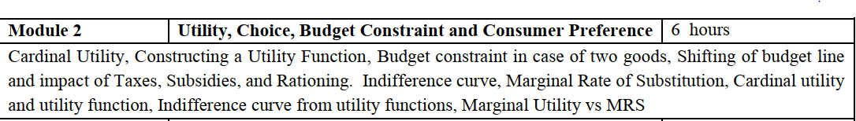

Slide 2


Slide 3
Introduction
Describes what a consumer can afford
how the consumer determines what is best

Slide 4


Slide 5
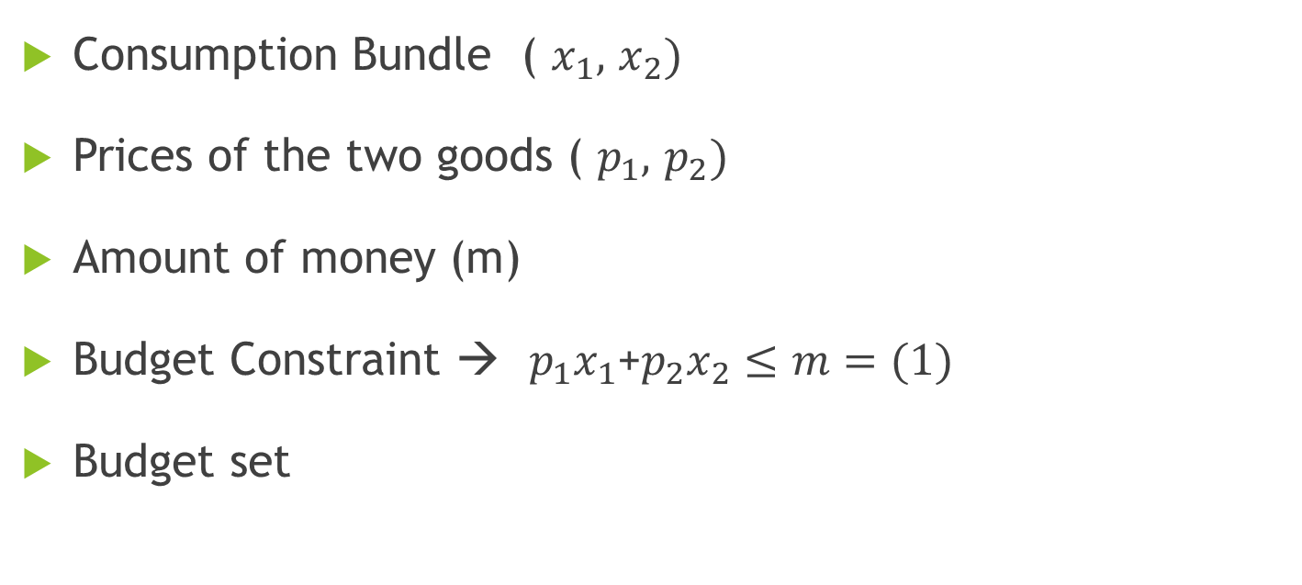
The Budget Constraint
Consumption Bundle ( $x_{1},$ $x_{2})$
Prices of the two goods ( $p_{1},$ $p_{2})$
Amount of money (m)
Budget Constraint → $p_{1}x_{1}$+$p_{2}x_{2}≤m=(1)$
Budget set

Slide 6




Properties of budget set
y
Budget Line →${ p}_{1}x_{1}$+$p_{2}x_{2}=m \left(2\right)$
$x_{2}=\frac{m}{p_{2}}−\frac{p_{1}}{p_{2}}x_{1}$ (3)
$$\frac{m}{p_{2}}$$
Budget line
Slope = -($\frac{p_{1}}{p_{2}})$
Vertical intercept
Slope
$$\frac{m}{p_{1}}$$
x

Slide 7
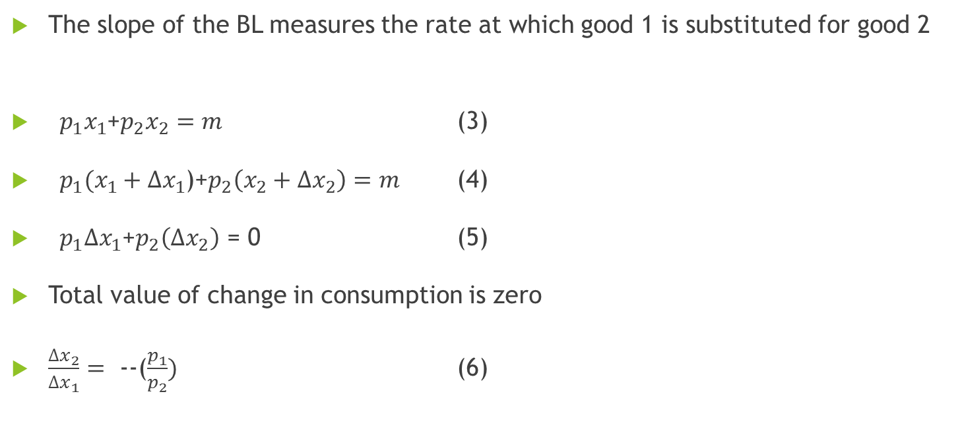
Slope and opportunity cost
The slope of the BL measures the rate at which good 1 is substituted for good 2
${ p}_{1}x_{1}$+$p_{2}x_{2}=m$ (3)
${ p}_{1}(x_{1}+∆x_{1}$)+$p_{2}\left(x_{2}+∆x_{2}\right)=m$ (4)
${ p}_{1}∆x_{1}$+$p_{2}\left(∆x_{2}\right)$ = 0 (5)
Total value of change in consumption is zero
$\frac{∆x_{2}}{∆x_{1}}=$ --($\frac{p_{1}}{p_{2}})$ (6)

Slide 8
Shifting of budget line
Impact of taxes, subsidies and rationing
Indifference curve

Slide 9


Changes in Budget Line (Changes in Prices and Income)
y
$$\frac{m^{I}}{p_{2}}$$
Changes in Income
$x_{2}=\frac{m}{p_{2}}−\frac{p_{1}}{p_{2}}x_{1}$ (2.4)
$$\frac{m}{p_{2}}$$
Slope = -($\frac{p_{1}}{p_{2}})$
$$\frac{m}{p_{1}}$$
x
$$\frac{m^{I}}{p_{1}}$$

Slide 10
Changes in Budget Line (Changes in Prices and Income)
y
Changes in Prices
$x_{2}=\frac{m}{p_{2}}−\frac{p_{1}}{p_{2}}x_{1}$ (2.4)
$$\frac{m}{p_{2}}$$
Slope = -($\frac{p_{1}}{p_{2}})$
$$\frac{m}{p_{1}}$$
$$\frac{m}{P_{1}^{I}}$$
x

Slide 11
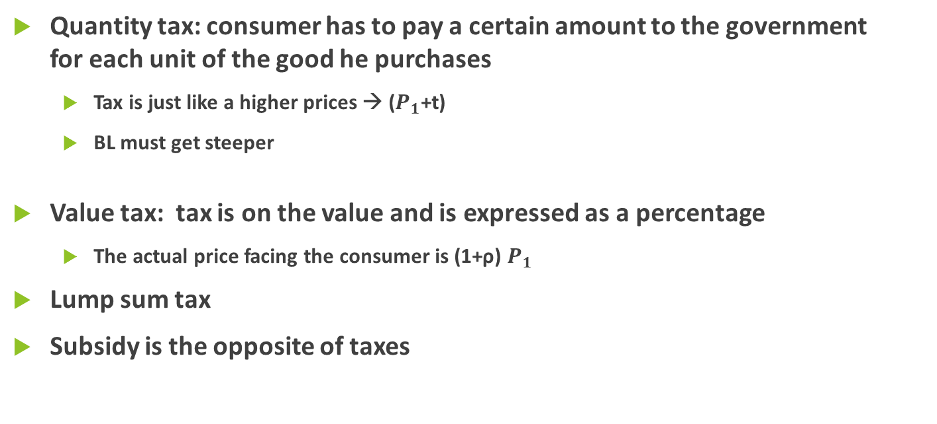
Taxes, Subsidies and Rationing
Quantity tax: consumer has to pay a certain amount to the government for each unit of the good he purchases
Tax is just like a higher prices → ($P_{1}$+t)
BL must get steeper
Value tax: tax is on the value and is expressed as a percentage
The actual price facing the consumer is (1+ρ) $P_{1}$
Lump sum tax
Subsidy is the opposite of taxes

Slide 12


Rationing
Level of consumption of some good is fixed to be no larger than some amount
y
$$\frac{m}{p_{2}}$$
$$\frac{−}{x_{1}}$$
$$\frac{m}{p_{1}}$$
x

